Slide 1

Contractor Safety Orientation
Holland Board Of Public Works
General Site and Service Center

Slide 2
WELCOME
The Holland Board of Public Works (HBPW), owns and operates facilities to provide electric, water, sewer, traffic lights, and fiber optic utilities to the public. Contractors to the HBPW can expect to find a wide variety of working conditions and environments throughout the City of Holland, in HBPW facilities and in the Right of Way.
Notes:
Some HBPW facilities have site specific information that all contractor employees should be aware of when working at those sites.

Slide 3

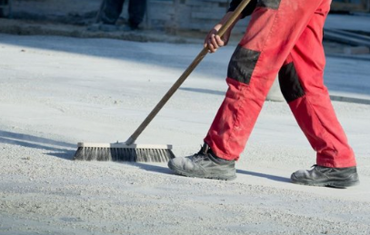
Administrative
Incident Reporting
  Any/All incidents must be reported to HBPW staff
  Incudes accidents, injuries, property damage, near-miss incidents, unsafe acts.
  Hazards not identified in pre-job planning should be reported to HBPW staff and properly mitigated to complete work safely.
Tobacco Usage
  HBPW facilities are a Tobacco-Free campus. This includes E-cigarettes
  Housekeeping
  Construction areas must be kept clean and free of trash and debris
  Materials must not block fire doors, equipment, alarms, electrical panels, start/stop switches, electrical panels, disconnects exit doors
  Work areas must be kept clear of all hoses, cords, and other materials out of walkways.
Chemical Storage – Do not store flammable combustible liquids in the building, keep away from exits and stairs.
  Horseplay, possession of alcoholic beverages, the illegal use of drugs, and the possession of firearms or weapons is prohibited.
After Hours Emergency Contact Info:
HBPW Service Center
  616-

Slide 4
Administrative Cont.
If you are provided a badge access card, you need to wear it where you can easily be identified as a BPW contractor. You are responsible for the card and if misplaced or lost, you need to report this promptly the project manager.
When arriving at the Service Center, there is a Kiosk located in our customer lobby or in the warehouse maintenance bay. Prior to your arrival the project manager will tell you which location to meet. Upon arrival, you will need to sign-in and get a printed badge. Once you have entered your information, an email or text will be sent to the project manager and they will meet you at your designated location. This lets HPBW send a text to inform you in the event of any chemical spill, fire, severe weather, or workplace violence.
Notes:
If you are provided a badge access card, you need to wear it where you can easily be identified as a BPW contractor. You are responsible for the card and if misplaced or lost, you need to report this promptly the project manager.

Slide 5
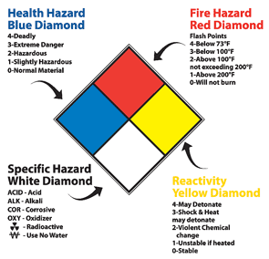
Contractor Safety
Safety Data Sheets (SDS’s)
  SDS sheets are available for all HBPW owned and supplied chemicals and will be provided upon request
  Contractor shall supply SDS sheets for all chemicals brought on site
Non exhaustive Examples of Onsite Hazardous Chemicals
  Propane
  Sewage
  Sewer Gas
  Mineral Oil
  Mercury
  Chlorine
  Unknown chemicals in the ROW
Notes:
***

Slide 6
Contractor Safety
Fire Alarms
  Exit at nearest point
  Report to nearest evacuation area
Sever Weather Notification
  Incudes severe storms and/or tornadoes
  Report to tornado shelters located inside the building.
  Wait for all clear from BPW.
First Aid Kits
  Locate BPW representative

Slide 7
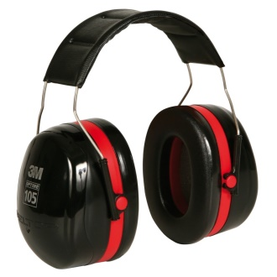
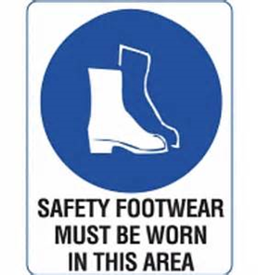
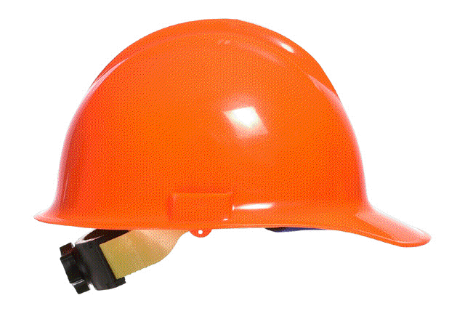
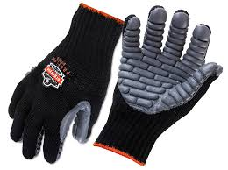
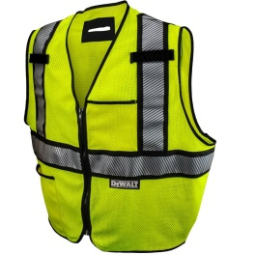
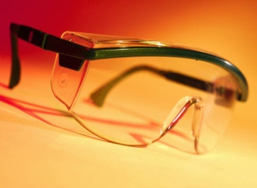
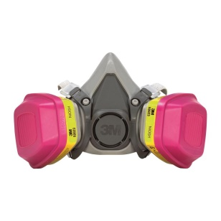
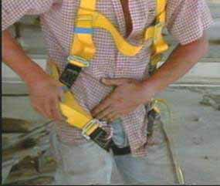
Contractor Safety
PPE
  PPE appropriate to the work shall be provided by the Contractor. Examples of this would include:
  Hard Hat
  Gloves
  Steel Toed Shoes
  Safety Glasses\ Face Shields
  Hearing Protection
  Fall Protection
  Arc Flash Protection
  High Visibility Clothing
  Voltage Proximity Sensor
  Voltage Rated Rubber Gloves
Notes:
It is the contractor’s responsibility to know the MIOSHA PPE requirements for the work activities they are performing and ensuring their employees have been trained on the proper use of the PPE they are required to use.

Slide 8
Contractor Safety
Blood borne Pathogens
  The Contractor may encounter or create confined spaces during the course of the work.
  Workers shall be able to identify a confined space.
  Entry into a confined space will be completed using either a Contractor supplied program or utilizing the HBPW entry program.
Safety Showers and Eyewash Stations
  N/A
Chemical Spill Procedure
  Notify HBPW of spill, what spilled and where the spill is.
  Evacuate affected areas if deemed necessary.

Slide 9
Contractor Safety
Hot Work (welding, cutting, grinding, etc.)
  BPW Hot Work Permit must be completed
Confined Space Entry
  The Contractor may encounter or create confined spaces during the course of the work.
  Workers shall be able to identify a confined space.
  Entry into a confined space will be completed using either a Contractor supplied program or utilizing the HBPW entry program.
Elevated Work
  Must follow MIOSHA regulations.
  Elevated work may be encountered from lift equipment, HBPW facilities and Contractor supplied work platforms.
  Contractor to supply all necessary PPE, fall protection, and fall arrest systems.
Arc Flash Compliance
  Notify HBPW contact before opening any electrical panel.
Lockout/Tagout
  Must follow HBPW Program
  Must coordinate with HBPW staff

Slide 10
Contractor Safety
Excavation
  Excavations shall comply with MIOSHA rules.
  MISSDIG shall be completed by the Contractor with a positive response before excavation starts.
  Excavation in the ROW will require a Street Cut Permit obtained by the Contractor from the City of Holland Transportation Department
Traffic
  Traffic Control shall be supplied by the Contractor.
  Traffic Control shall follow the latest edition of MUTCD guidelines.
  Traffic Control in place for over 4 hours will require a plan submittal and approval of City of Holland Transportation Department.
  City of Holland Transportation (616)928-2400
Parking
  Park only in designated areas only
  Follow entrance and exit signs and give right of way to pedestrians.
  Traffic going through the garage needs to be from the North doors to the South, and the vehicle needs to honk before going in and out of any garage door.

Slide 11
Questions?
Notes:
Contact your HBPW Representative for any and all specific questions or concerns on this information

