Slide 1


Contractor Safety Orientation
Holland Board Of Public Works
General Site and Service Center

Slide 2
WELCOME
The Holland Board of Public Works (HBPW), owns and operates facilities to provide electric, water, sewer, traffic lights, and fiber optic utilities to the public. Contractors to the HBPW can expect to find a wide variety of working conditions and environments throughout the City of Holland, in HBPW facilities and in the Right of Way.
Notes:
Some HBPW facilities have site specific information that all contractor employees should be aware of when working at those sites.

Slide 3

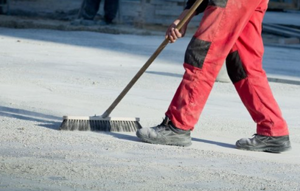
Administrative
Incident Reporting
  Any/All incidents must be reported to HBPW staff
  Incudes accidents, injuries, property damage, near-miss incidents, unsafe acts.
  Hazards not identified in pre-job planning should be reported to HBPW staff and properly mitigated to complete work safely.
Tobacco Usage
  HBPW facilities are a Tobacco-Free campus
  This includes E-cigarettes
  Housekeeping
  Construction areas must be kept clean and free of trash and debris
  Materials must not block fire doors, equipment, alarms, electrical panels or exit doors
  Horseplay, possession of alcoholic beverages, the illegal use of drugs, and the possession of firearms or weapons is prohibited.
After Hours Emergency Contact Info:
HBPW Power Plant
  616-355-1223

Slide 4
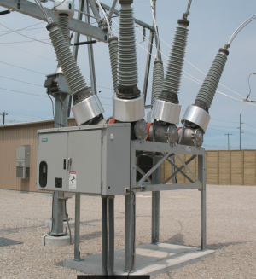
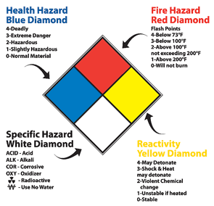
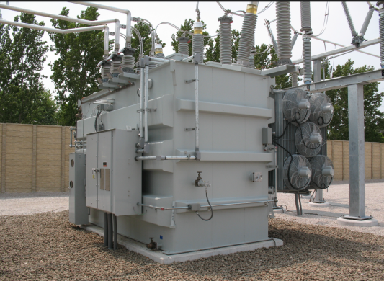
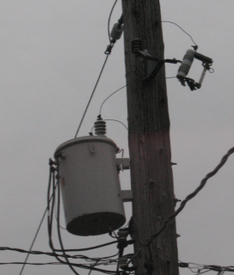
Contractor Safety
Safety Data Sheets (SDS’s)
  SDS sheets are available for all HBPW owned and supplied chemicals and will be provided upon request
  Contractor shall supply SDS sheets for all chemicals brought on site
Non exhaustive Examples of Onsite Hazardous Chemicals
  SF6 gas
  Sewage
  Sewer Gas
  Mineral Oil
  Mercury
  Chlorine
  Unknown chemicals in the ROW
Notes:
***

Slide 5
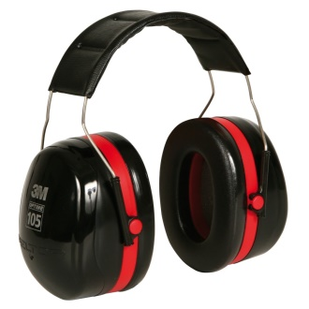
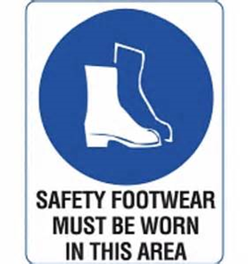
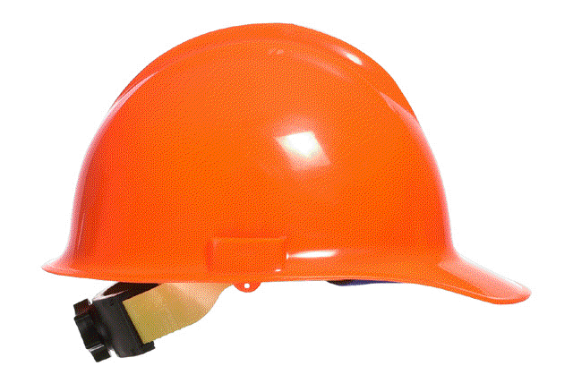
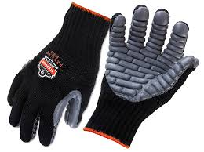
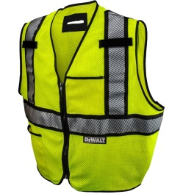
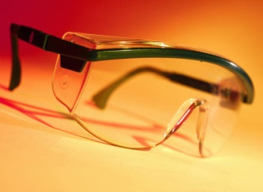
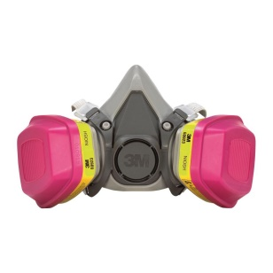
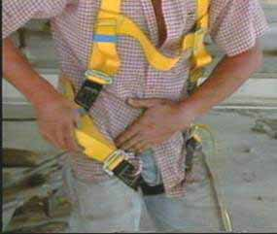
Contractor Safety
PPE
  PPE appropriate to the work shall be provided by the Contractor. Examples of this would include:
  Hard Hat
  Steel Toed Shoes
  Safety Glasses\ Face Shields
  Hearing Protection
  Fall Protection
  Arc Flash Protection
  High Visibility Clothing
  Voltage Proximity Sensor
  Voltage Rated Rubber Gloves
Notes:
It is the contractor’s responsibility to know the MIOSHA PPE requirements for the work activities they are performing and ensuring their employees have been trained on the proper use of the PPE they are required to use.

Slide 6
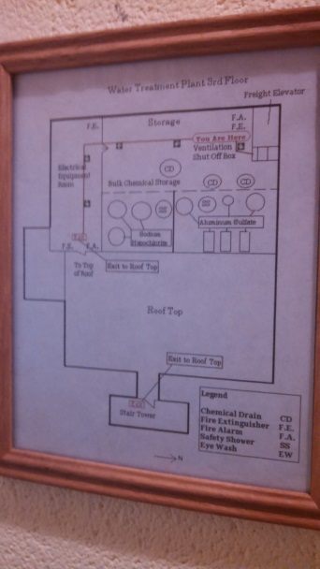
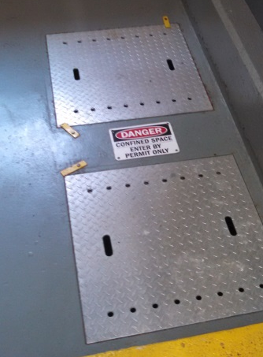
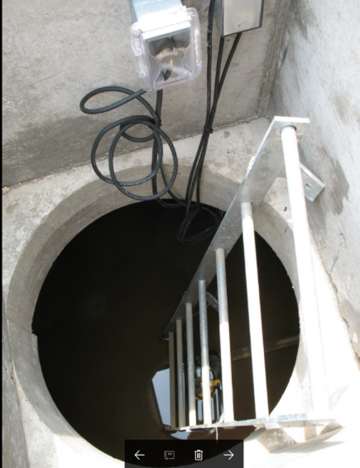
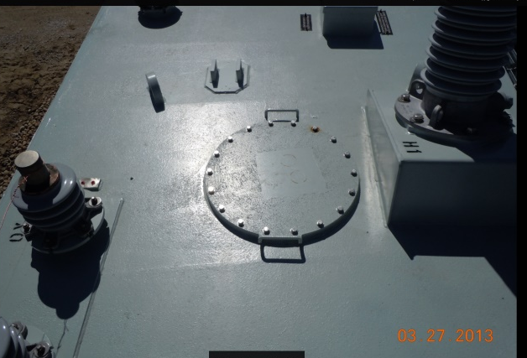
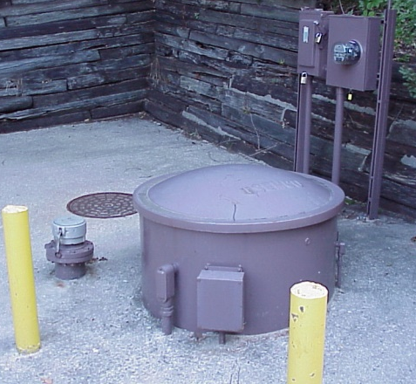
Contractor Safety
Confined Space Entry
  The Contractor may encounter or create confined spaces during the course of the work.
  Workers shall be able to identify a confined space.
  Entry into a confined space will be completed using either a Contractor supplied program or utilizing the HBPW entry program.

Slide 7
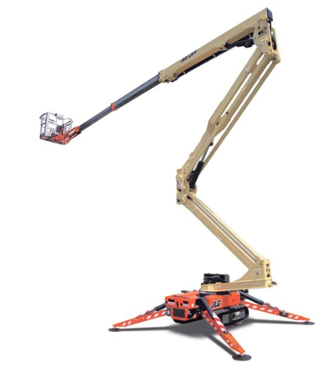
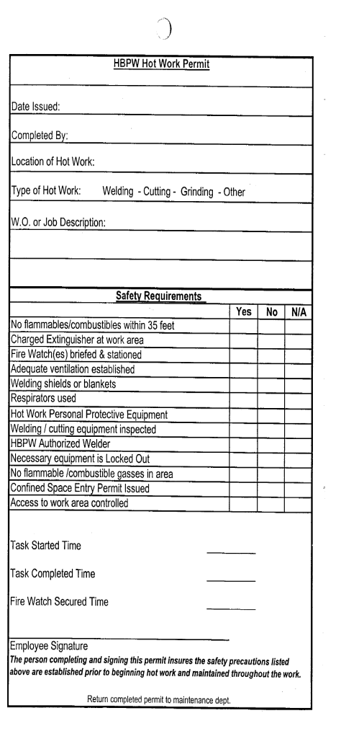
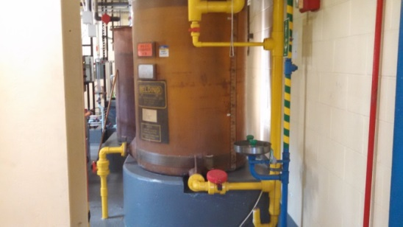
Contractor Safety
Hot Work (welding, cutting, grinding, etc.)
  BPW Hot Work Permit must be completed
Lockout/Tagout
  Must follow HBPW Program
  Must coordinate with HBPW staff
Elevated Work
  Must follow MIOSHA regulations.
  Elevated work may be encountered from lift equipment, HBPW facilities and Contractor supplied work platforms.
  Contractor to supply all necessary PPE, fall protection, and fall arrest systems.

Slide 8
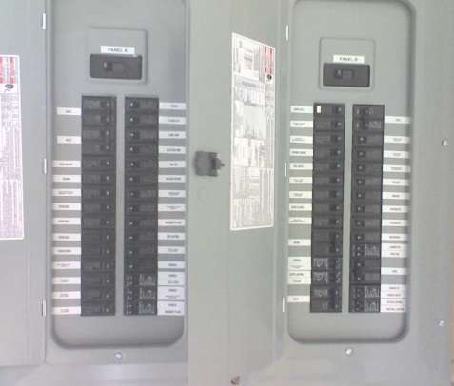
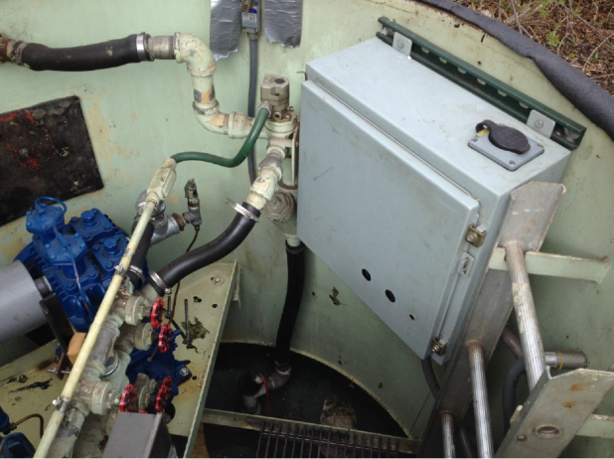
Contractor Safety
Arc Flash Compliance
  Notify HBPW contact before opening any electrical panel.
Lead Paint
  As a historic government charter utility, the HBPW has operated facilities for over 115 years. Lead paint has been used and removed at various locations. Your HBPW Representative will be able to provide a facility history of lead paint.
  Asbestos
    Work has been completed to remove all known areas of asbestos from HBPW facilities, however, any areas of concern encountered should be brought to the attention of HBPW staff.

Slide 9
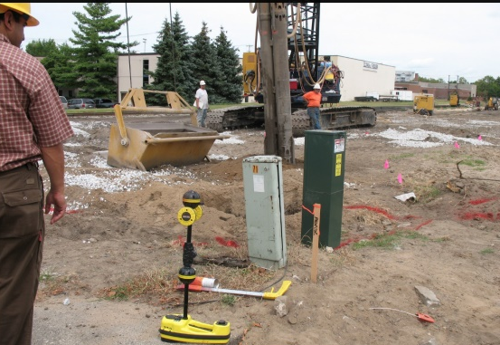
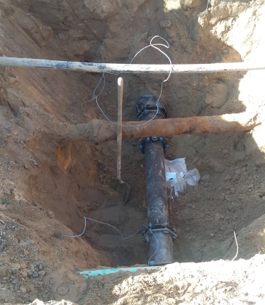

Contractor Safety
Excavation
  Excavations shall comply with MIOSHA rules.
  MISSDIG shall be completed by the Contractor with a positive response before excavation starts.
  Excavation in the ROW will require a Street Cut Permit obtained by the Contractor from the City of Holland Transportation Department
Traffic
  Traffic Control shall be supplied by the Contractor.
  Traffic Control shall follow the latest edition of MUTCD guidelines.
  Traffic Control in place for over 4 hours will require a plan submittal and approval of City of Holland Transportation Department.
  City of Holland Transportation (616)928-2400

Slide 10
Questions?
Notes:
Contact your HBPW Representative for any and all specific questions or concerns on this information

